Slide 1
01
APPLIED MACHINE LEARNING IN THE CLOUD
CHARACTERIZING
EAGLE-3
HIGH
CONCURRENCY
CLOUD
GPUS
SPECULATIVE DECODING IN vLLM
EAGLE-3
Performance across Cloud GPUs and Apple Silicon
under high Concurrency
APPLE
SILICON
HIGH
PERFORMANCE
- Aaryaman - Shreya Banga - Rajvardhan - Himanshu Jhawar (hj2713)

Slide 2

02
THE CORE PROBLEM & OUR APPROACH
BREAKING THE MEMORY BANDWIDTH BOTTLENECK
THE PROBLEM
SPECULATIVE DECODING
WHY EAGLE-3?
LLM inference is memory-bandwidth bound.
Most time is spent moving weights from VRAM to compute cores — not actually computing.
A small draft model guesses multiple tokens.
The large 8B target model verifies them in parallel.
Accepted tokens = free speedup.
Uses a lightweight feature-level head rather than a separate draft model.
Higher acceptance rates → more tokens per verification pass.
EAGLE-3 PIPELINE:
DRAFT TOKENS
→
VERIFY (8B)
→
ACCEPT
→
SPEEDUP ACHIEVED

Slide 3
03
EXPERIMENTAL ARCHITECTURE
RIGOROUS CROSS-PLATFORM MATRIX
3 Tasks × 3 Hardware Tiers × 5 Concurrency Levels = 45 Total Configurations
A100 (80GB)
L4 (24GB)
Mac (Unified Memory)
High-end cloud GPU
HBM2e memory
Cost-efficient cloud GPU
GDDR6 memory
Apple Silicon
Shared memory architecture
TARGET MODEL:
Llama-3.1-8B-Instruct (Greedy Decoding)
Chat
ShareGPT
Code
HumanEval
Summarization
CNN
CONCURRENCY LEVELS:
1
4
8
16
32
simultaneous users
⚠ THE CONSTRAINT: L4 (24GB VRAM)
Baseline ~20GB | EAGLE-3 ~22GB | Sequential runner: Run → Kill → Clean VRAM → Next config
Limited 24GB VRAM required strict sequential execution to prevent OOM crashes.

Slide 4
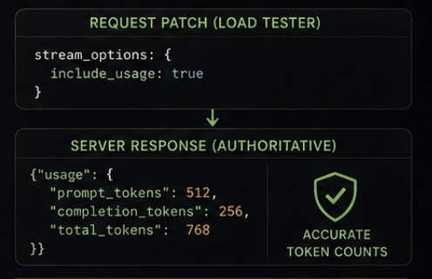
04
THE "GOTCHA" — DEBUGGING vLLM
UNCOVERING THE vLLM CHUNKING BUG
1
2
3
THE SCARE
THE INVESTIGATION
THE FIX
Initial data showed EAGLE-3 was
slower than baseline.
Throughput: Baseline 100 TPS
vs EAGLE-3 72 TPS
Raw logs: chars/chunk heavily skewed.
Baseline: 7.7 chars/chunk
EAGLE-3: 3.8 chars/chunk
vLLM batches multiple accepted tokens
into ONE SSE chunk — counting
chunks undercounted EAGLE-3 by ~2×
→
→
EAGLE-3 looked worse!
Correct metrics. Experiment saved.
AFTER THE FIX:
✓ Throughput 2×–3× higher
✓ True speedup revealed (not 0.5×)
✓ Data integrity restored with server counts
✓ Results we can trust and publish

Slide 5
05
THROUGHPUT & SPEEDUP
EAGLE-3 IS AN UNCONDITIONAL WIN
Speedup Heatmap: EAGLE-3 TPS ÷ Baseline TPS | All values > 1.0 = EAGLE-3 wins
A100 (80GB)
L4 (24GB)
TASK
c=1
c=4
c=8
c=16
c=32
TASK
c=1
c=4
c=8
c=16
c=32
Chat (ShareGPT)
1.31×
1.50×
1.98×
1.79×
1.59×
Chat (ShareGPT)
1.20×
1.36×
1.61×
1.59×
1.43×
★ Code (HumanEval)
2.87×
2.67×
2.38×
2.13×
1.80×
★ Code (HumanEval)
2.91×
2.73×
2.44×
2.12×
1.74×
Summarization (CNN)
2.33×
1.88×
1.77×
1.55×
1.33×
Summarization (CNN)
2.27×
1.96×
1.81×
1.61×
1.28×
★ Peak: Code @ c=1 on L4 = 2.91× | Minimum: Chat @ c=1 on L4 = 1.20× | No crossover observed at any concurrency level — EAGLE-3 always wins

Slide 6
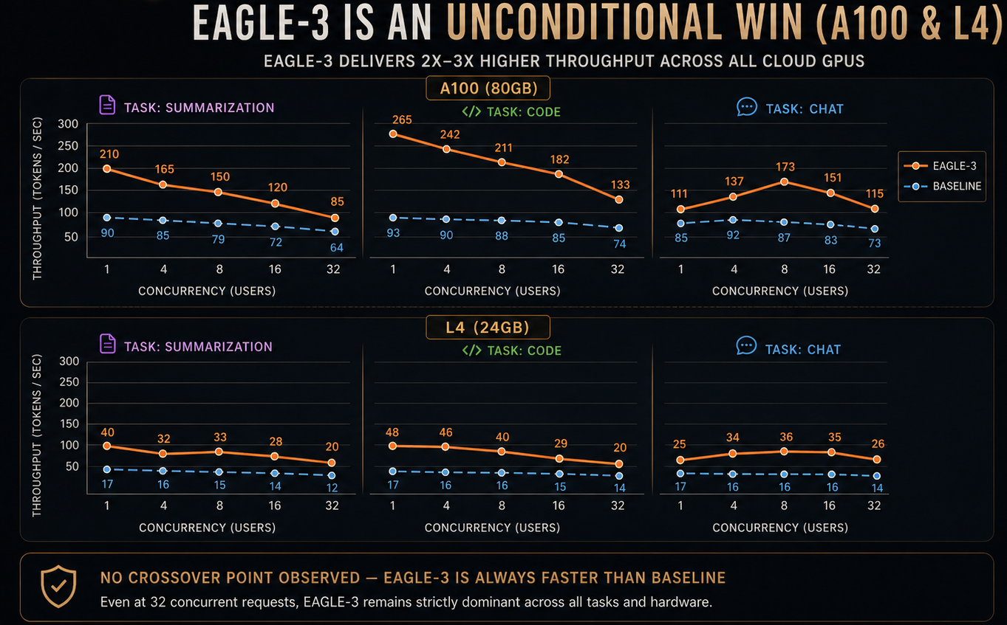
06
THROUGHPUT DEEP DIVE
TOKENS PER SECOND: EAGLE-3 vs BASELINE

Slide 7
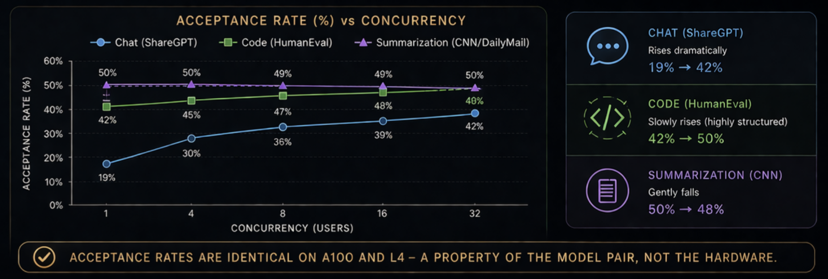
07
TASK VARIABILITY & ACCEPTANCE RATES
WHY DOES ACCEPTANCE RATE CHANGE WITH CONCURRENCY?

Slide 8
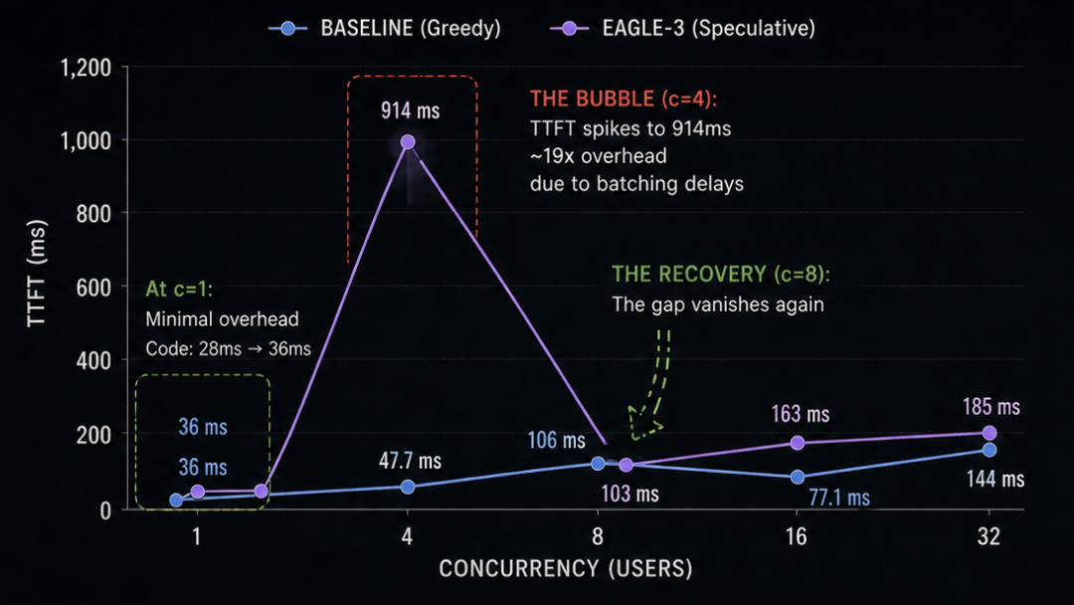
08
TTFT TRADE-OFF
WHEN DOES THE OVERHEAD MATTER?
TTFT (Time-to-First-Token) on A100 Across Concurrency Levels
1
AT c=1
TTFT overhead is minimal.
Code: 28ms → 36ms only.
2
THE BUBBLE
At c=4 (Chat), TTFT spikes to
914ms — ~19× overhead due to
batching delays.
3
THE RECOVERY
By c=8, the gap vanishes again.
103ms vs 106ms — essentially equal.
TAKEAWAY
TTFT
Time to First Token
(user-perceived latency)
TPOT
Time Per Output Token
(generation speed)
=
Total Experience:
Overhead vs sustained faster generation
TPOT (generation speed) always improves, but initial TTFT has a scheduling bubble at low-medium concurrency.

Slide 9
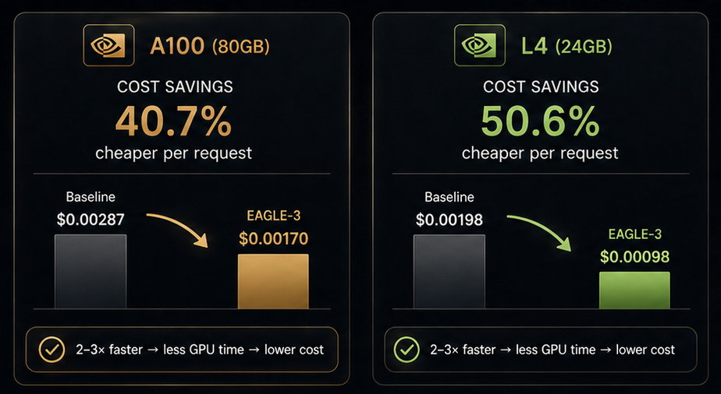
09
COST-PERFORMANCE FRONTIER
CLOUD ECONOMICS: 50% CHEAPER COMPUTE
EAGLE-3 delivers 2–3× higher throughput → 40–50% lower cost per request
★ THE SWEET SPOT
L4 + EAGLE-3 matches A100 Baseline throughput
(~90 vs ~87 TPS) at 66% lower cost ($0.00287 → $0.00098).
2–3× faster → less GPU time → lower cost.
Maximum performance at minimum cost.

Slide 10
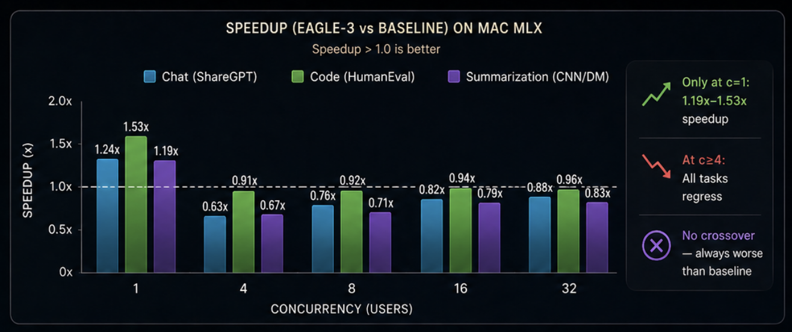
10
THE APPLE SILICON REALITY
THE EDGE CASE: MAC MLX
Speculative decoding on Apple Silicon is a single-user win, but a multi-user failure.
1
SINGLE-USER SUCCESS
Genuine 1.19×–1.53× speedup at c=1.
Best for local, single-user agents.
2
MULTI-USER CATASTROPHE
Regressions across all tasks at c≥4.
Throughput drops below baseline.
3
THE UNFAIRNESS PROBLEM
At c=32, CV = 188% (Extremely Unfair).
Fastest 10%: 150ms vs Slowest 10%: 45,000ms (45 sec!)
TAKEAWAY: Mac MLX is best for single-user workloads. Under concurrency, it becomes unpredictable and unusable.

Slide 11
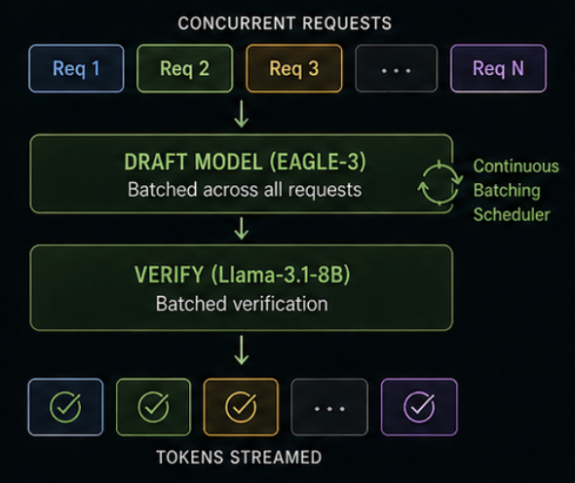
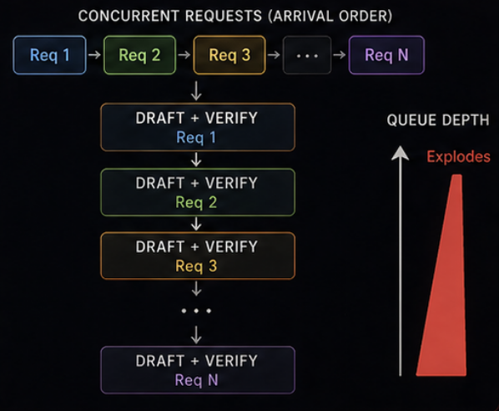
11
THE ARCHITECTURE INSIGHT
WHY DID THE MAC FAIL? SCHEDULING VS. ALGORITHMS
The difference is in how speculative decoding work is scheduled across concurrent requests.
✓ vLLM (CLOUD GPUs): CONTINUOUS BATCHING
✕ MLX (MAC): SERIAL SPECULATIVE PASSES
Batches speculative decoding across requests → Stable at scale
Processes speculative passes serially → Queue depth explodes
HOW IT WORKS
R1
R2
R3
R4
R5
HOW IT WORKS
DRAFT+VERIFY — Req 1
All requests are batched together for both draft and verify passes. GPU stays busy.
↓
Each request runs its entire draft+verify cycle before the next request begins. No cross-request batching.
DRAFT (EAGLE-3) — Batched
↓
DRAFT+VERIFY — Req 2
↓
VERIFY (Llama-3.1-8B) — Batched
↓
DRAFT+VERIFY — Req 3
RESULT AT SCALE
RESULT AT SCALE
↓
✓ High GPU utilization
✕ Low GPU utilization
DRAFT+VERIFY — Req 4
✓ Stable TTFT & TPOT
✕ TTFT becomes huge
✓ No queue explosion
✕ Massive queue buildup
✓ Scales to 32+ users
✕ Regressions at c≥4
TAKEAWAY: The Mac regressions are an architectural scheduling failure, not a failure of speculative decoding theory.

Slide 12
12
CONCLUSIONS & RECOMMENDATIONS
FINAL TAKEAWAYS
Actionable conclusions from our rigorous experimentation
1
CLOUD GPUs (A100 / L4)
2
CODE GENERATION: BEST USE-CASE
3
EDGE DEPLOYMENTS (MAC MLX)
EAGLE-3 is an unconditional win.
Enable by default in production.
Consistently delivers the highest gains.
Strictly a single-user tool right now.
2×–3× higher throughput across all tasks
Peak 2.9× speedup on L4 at c=1
Good at c=1 (1.19×–1.53× speedup)
Up to 2.91× speedup (Code, L4, c=1)
Highest acceptance rates (42% → 50%)
Collapses at c≥4 across all tasks
40–50% lower cost per request
Most structured outputs = more predictable speculation
Extreme unfairness at c=32 (CV 188%)
No crossover even at 32 concurrent users
First place for throughput, cost, and user experience
Architectural scheduling bottleneck in MLX
TURN IT ON. LEAVE IT ON.
It's strictly better.
IF YOU WRITE CODE,
YOU WIN BIG WITH EAGLE-3.
USE FOR LOCAL, SINGLE-USER
AGENTS ONLY.

